Slide 1
SYLVAN HILLS MIDDLE SCHOOL
Principal Artesza Portee

Slide 2
Sylvan Hills Middle School

Slide 3
Norms
This is a meeting of the GO Team. Only members of the team may participate in the discussion. Any members of the public present are here to quietly observe.
We will follow the agenda as noticed to the public and stay on task.
We invite and welcome contributions of every member and listen to each other.
We will respect all ideas and assume good intentions.

Slide 4
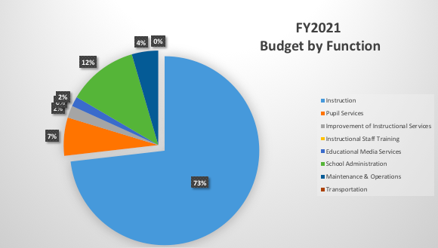
Budget by Function (Required)

Slide 5
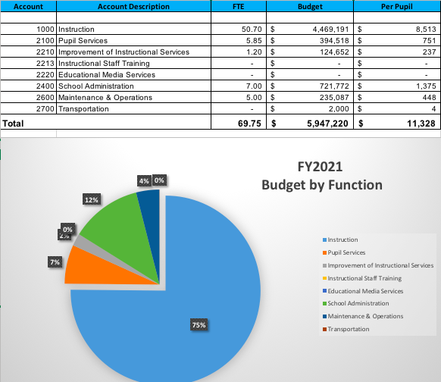
Sylvan Hills Middle School
Artesza Portee, Principal
Projected Enrollment: 525
Reduced by (-236 ,000)

Slide 6
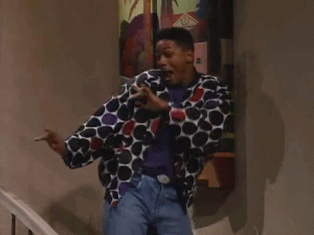
Things to Know:
Reduced by (-236 ,000)
-No Staffing cuts

Slide 7
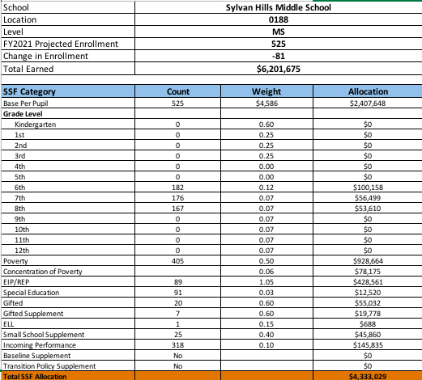
School Allocation

Slide 8
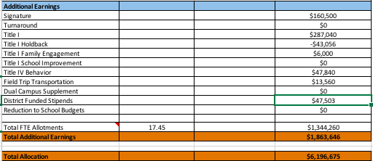
School Allocation Cont.

Slide 9
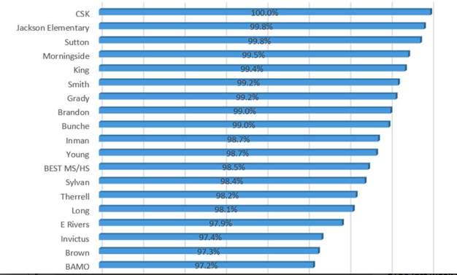
Principal’s Report
Staffing Vacancies
Principal
English Language Arts Teacher
Student Engagement: Twenty-eight (28) schools achieved above 95% cumulative student login rates since 3/16/20 (see chart below).

Slide 10
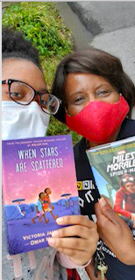
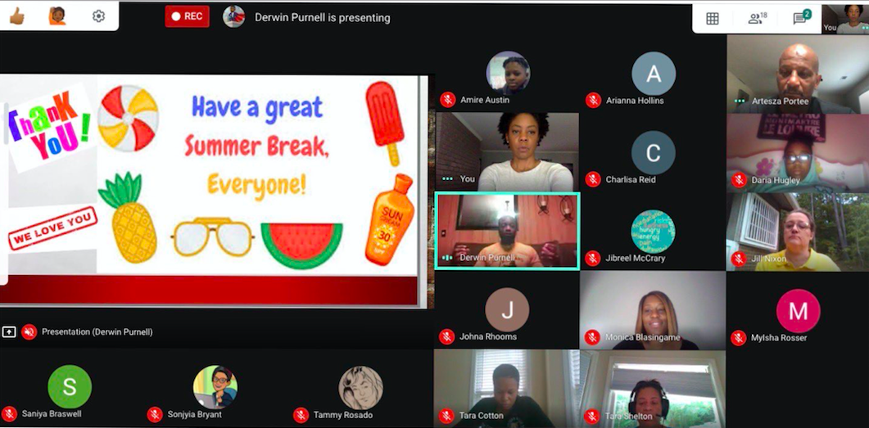
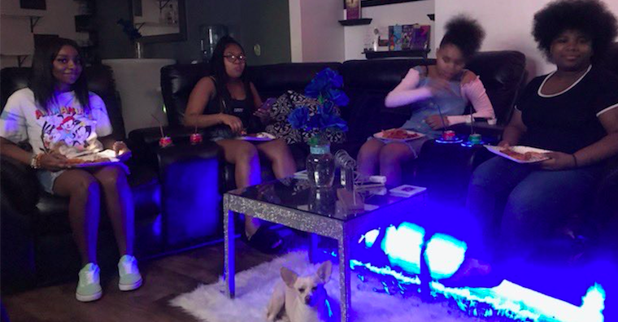
Highlight on Engagement during Covid-19
DAILY SEL Sessions hosted by Mr. Purnell and the SEL Team
Virtual Author Chats and
Book Distribution
8th Grade
Virtual Prom

Slide 11
Questions?

